Slide 1
Data Modeling & Starting Design
Team Alexandria

Slide 2
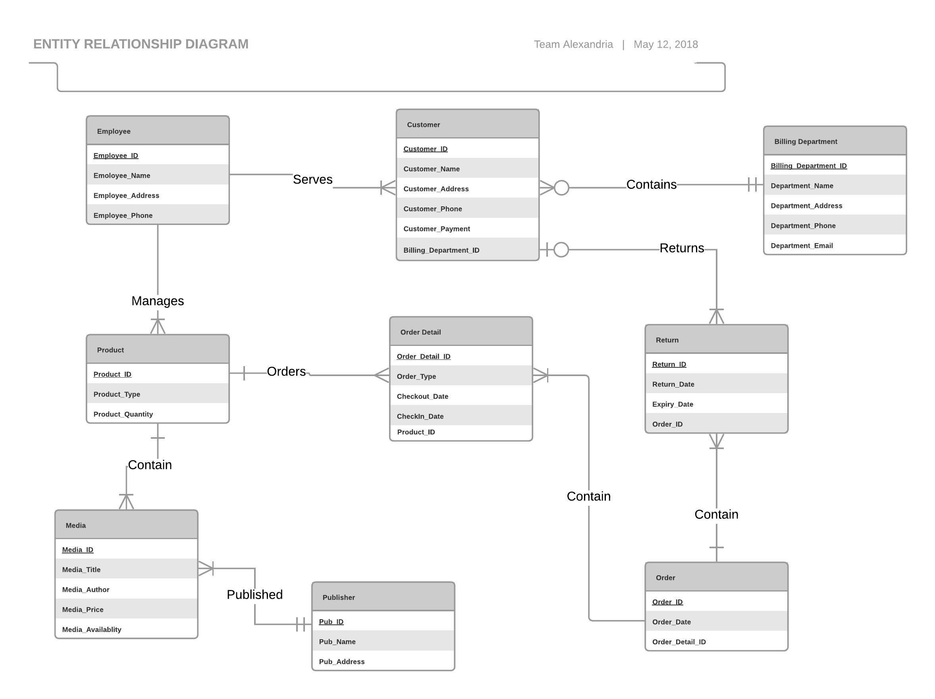
Entity Relationship Diagram

Slide 3
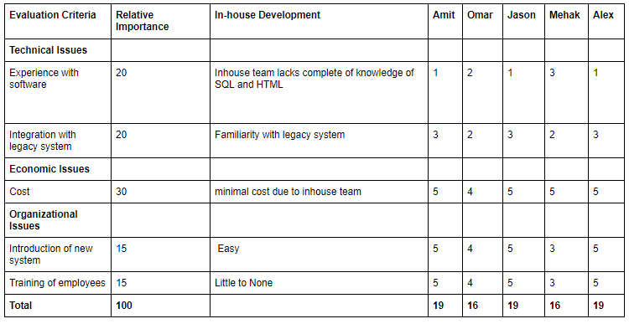
Alternative Matrix #1

Slide 4
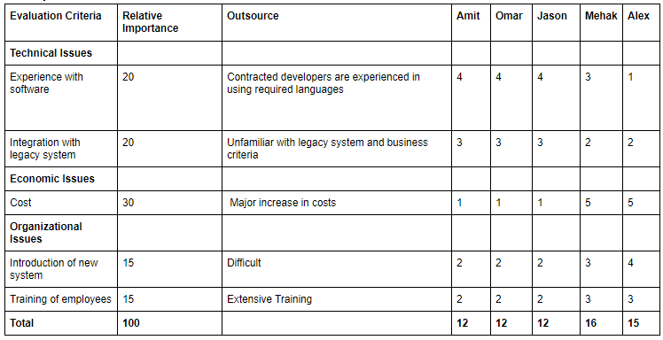
Alternative Matrix #2

Slide 5
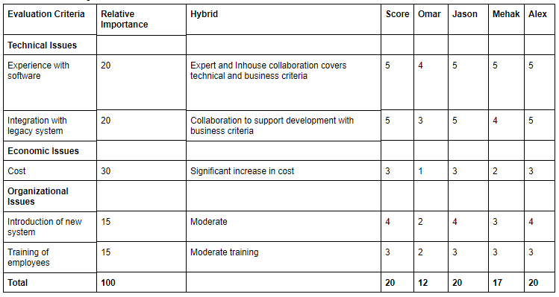
Alternative Matrix #3

Slide 6
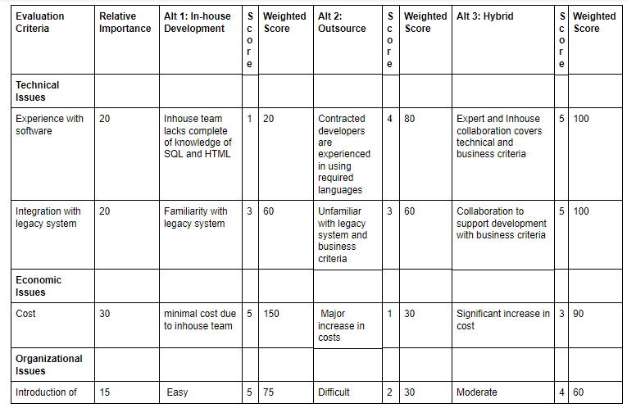
Team Matrix

Slide 7
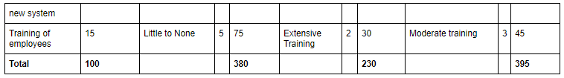
Team Matrix (Cont.)

Slide 8
Justification
While providing a rating for each alternative majority team members had similar scores for each alternative. This made it very difficult to pick one of the three. In the end we simply added the ratings for each alternative and decided to go with the one that had the highest rating by a majority. The alternative that had the highest majority rating was hybrid development of the application. We discussed it after the rating was concluded and felt like having experts that are fluent with many more coding languages implement inhouse ideas would be ideal choice.

Slide 9
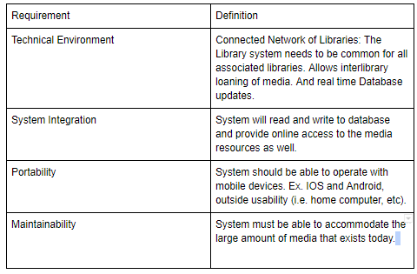
Operational Requirements

Slide 10
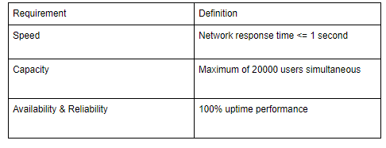
Performance Requirements

Slide 11
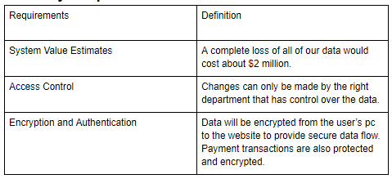
Security Requirements

Slide 12
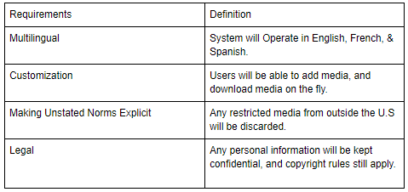
Cultural/Political Requirements

Slide 13
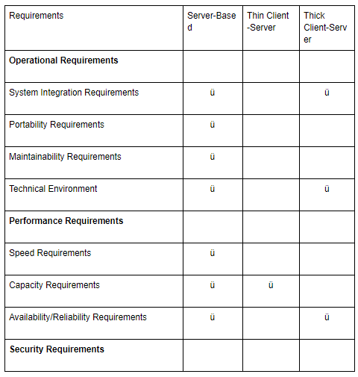
Architecture

Slide 14
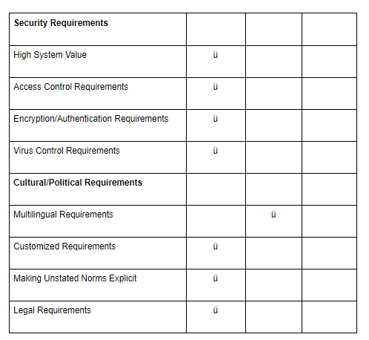
Architecture ( Cont.)

Slide 15
Decision
Since we need a system of interconnected libraries, a three-tiered Client-Server Architecture would be best suitable because we have different specialized servers where each one handles a different task. The application server will also handle the web-related logic as well. We chose a three tiered client because it can help you update the technology of one tier without affecting the other areas of the application. For example if we want to update our database server, we can do so without slowing down any other communications we might be receiving. We also chose the three tier because we can always add more tiers and continue to scale up. It also will help us maintain code base, where managing presentation code and business logic separately is easily doable.

Slide 16
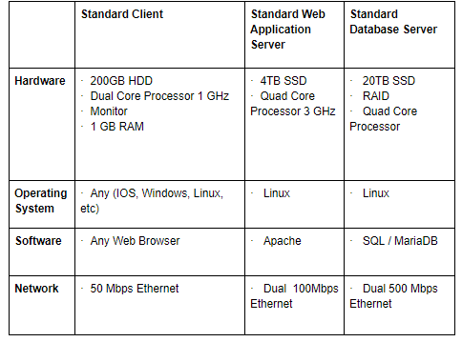
Hardware & Software Specifications

Slide 17
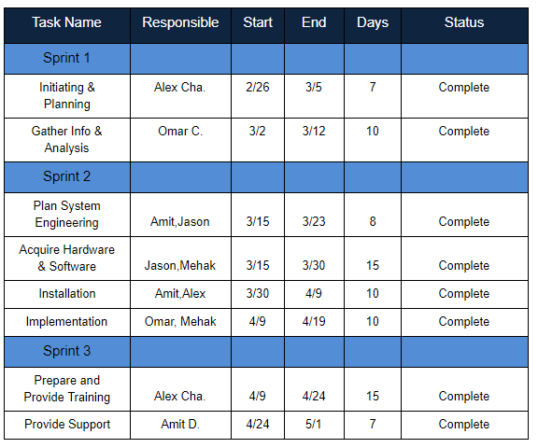
Updated Work Plan

Slide 18
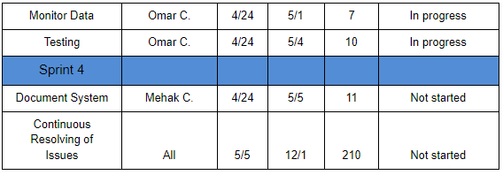
Updated Work Plan (Cont.)

